Slide 1



A Comparative Study of Machine Learning and Deep Learning in Network Anomaly-Based Intrusion Detection Systems
Mohab Sameh Ibrahim Abdel-Wahab
Dr. Ayman Atia
Eng. Ahmed Neil
7, December 2020

Slide 2
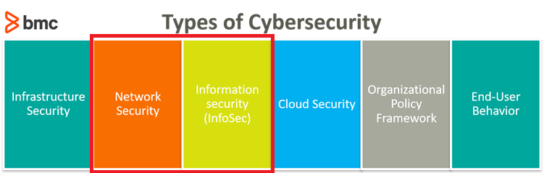
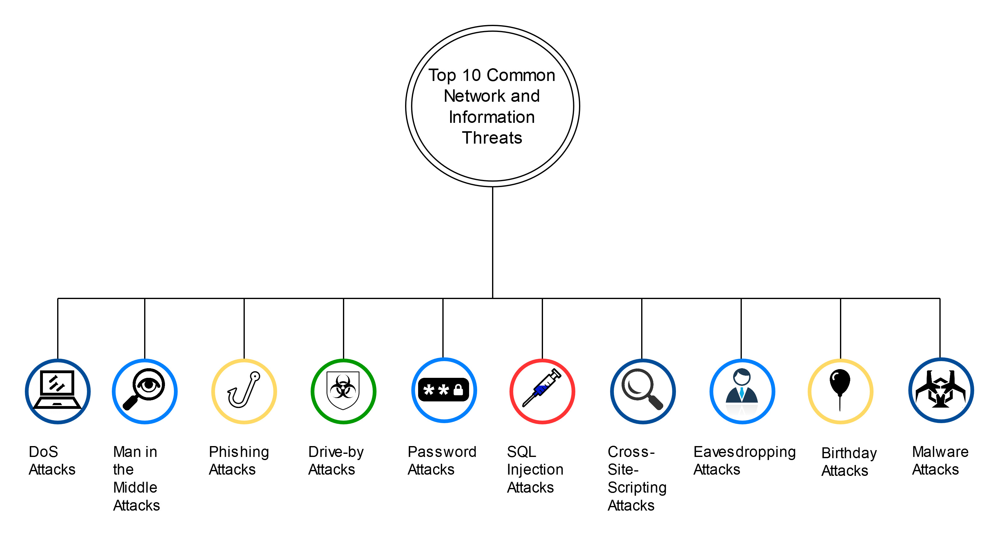
Intro (1/2)
Cybersecurity -> Defending Computers, mobile devices, etc. from malicious attacks.
Potential Network & Information Threats

Slide 3
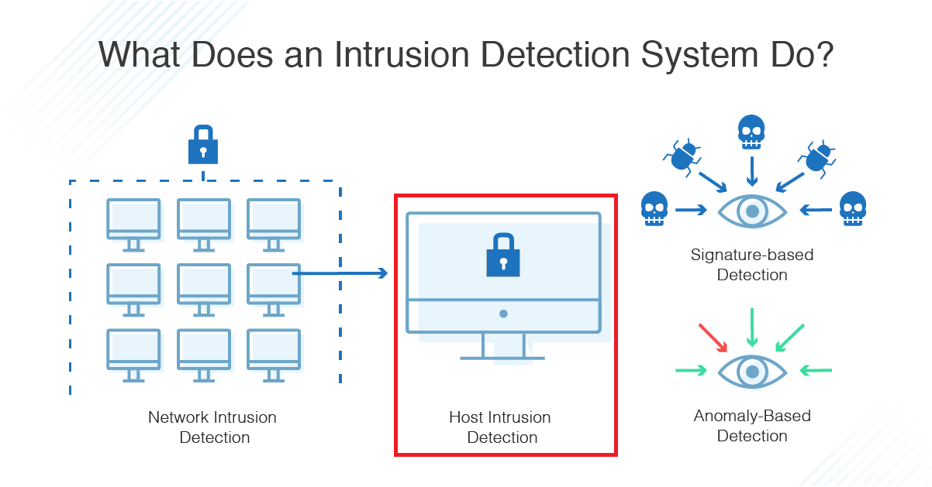
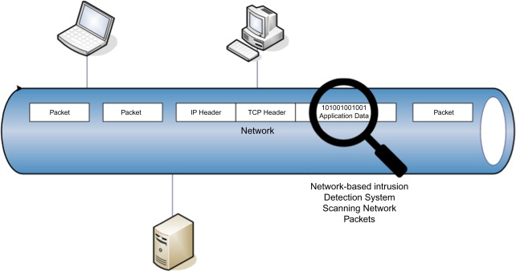
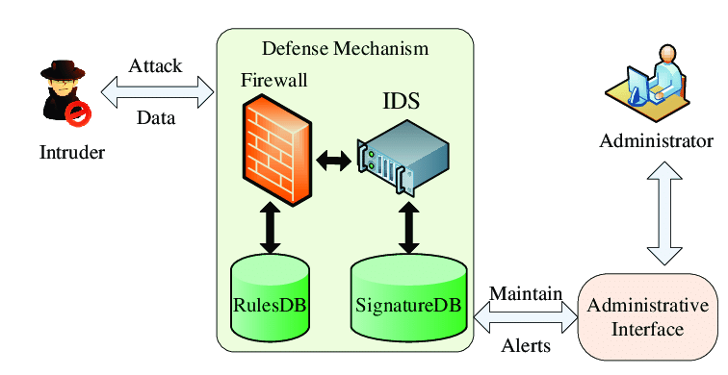
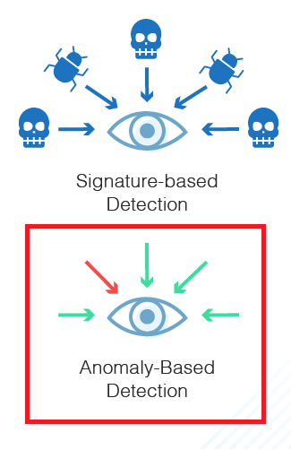
Intrusion Detection Systems
Intro (1/2) cont.
Intrusion Detection Systems (IDS):
Network IDS (NIDS)
Host IDS (HIDS)
Two types:
Signature-Based
Anomaly-Based

Slide 4



Anomaly-Based IDS
Intro (2/2)
IDS + Deep Learning = Anomaly-Based IDS
Challenges:
Enhancing real-life datasets
Malicious attacks are constantly changing
Applying more accurate Hybrid Deep Learning Methods
High Network Traffic
Client-Sided Machine Learning IDS for Mobile Devices

Slide 5
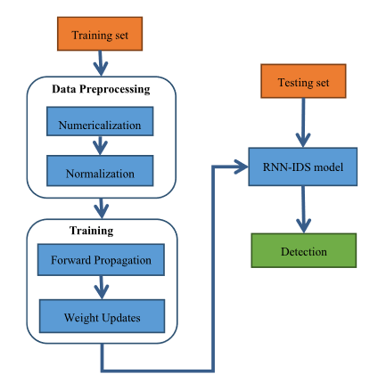
A Deep Learning Approach for Intrusion Detection Using Recurrent Neural Networks
Related Work (2/2)
Method used: Recurrent Neural Networks (RNN)
Dataset: NSL-KDD
Detection of the 5 classes
Accuracy: 97.09%
Offline Detection

Slide 6
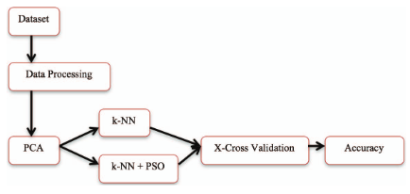
INTRUSION DETECTION SYSTEM USING HYBRID BINARY PSO AND K-NEAREST NEIGHBORHOOD ALGORITHM
Related Work (2/2)
Method used: K-NEAREST NEIGHBORHOOD (KNN) & Particle Swarm Optimization Hybrid
Dataset: KDD-99
Detection of the 5 classes
Accuracy: 98.678%
Offline Detection

Slide 7


Problem Statement
Lack of an enhanced Hybrid Deep Learning Intrusion Detection System with enhanced accuracy and enhanced datasets.

Slide 8
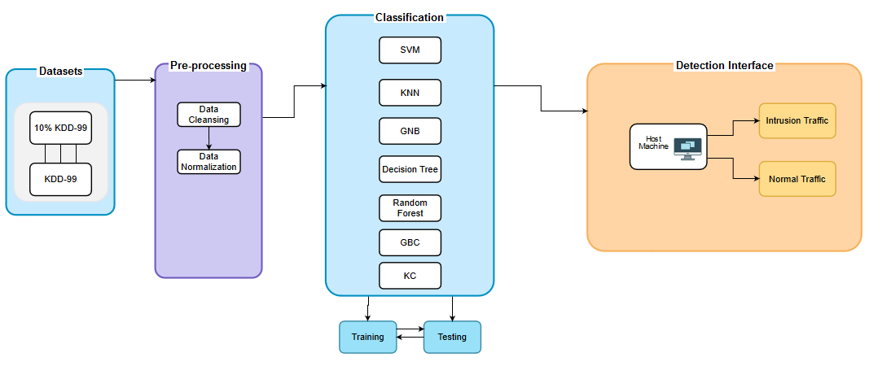
Experiment: System Overview

Slide 9
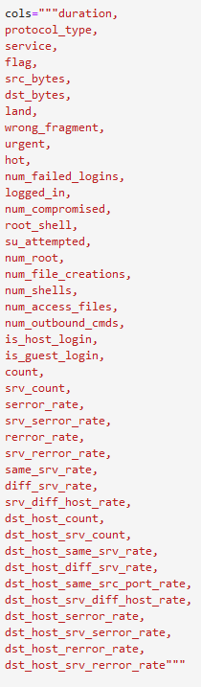
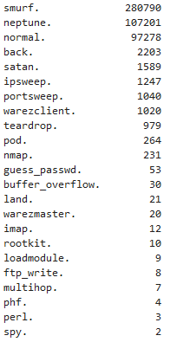
Experiment: Input
Data Extraction: KDD-99 public dataset (http://kdd.ics.uci.edu/databases/kddcup99/kddcup99.html)
KDD-99 Dataset:
Real-life network packets
Most widely used dataset
41 features
4.9 million packets
Features:
Attack Types & Frequency:

Slide 10
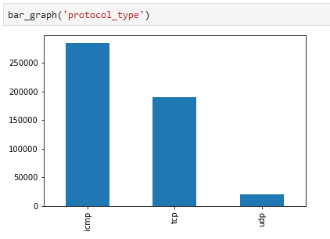
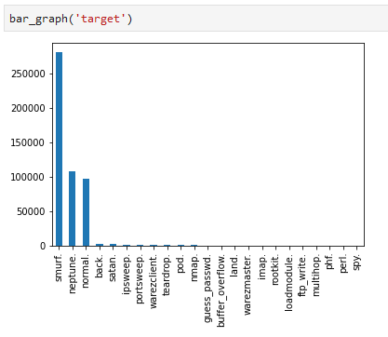
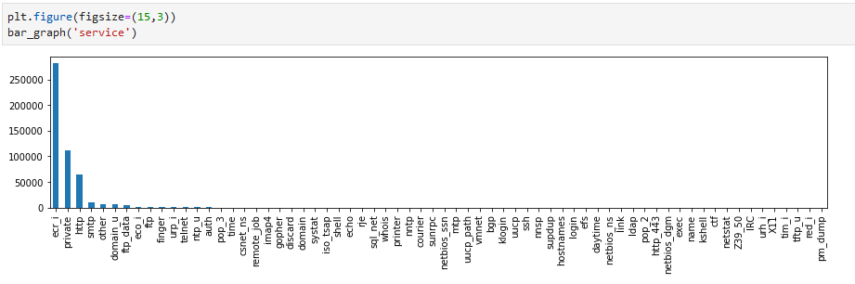
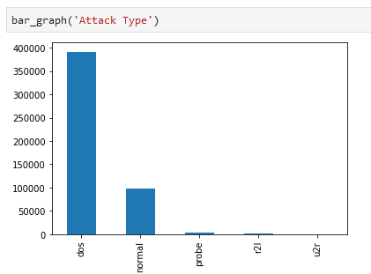
Experiment: Pre-Processing
Visualization
Cleansing null packets
Normalization of Highly-Variant Data
Correlation Analysis & Feature Selection
Label Encoding of Categorical Features
Splitting training & testing datasets

Slide 11
Experiment: Classification
K-Nearest Neighbor Classifier (KNN)
Random Forest (RF)
Support Vector Machines (SVM)
Long-Short-Term-Memory (LSTM)
Gaussian Naïve Bayes (GNB)
Decision Tree (DT)
Logistic Regression (LR)
Gaussian Naïve Bayes
Gradient Boosting Classifier
Keras Classifier

Slide 12
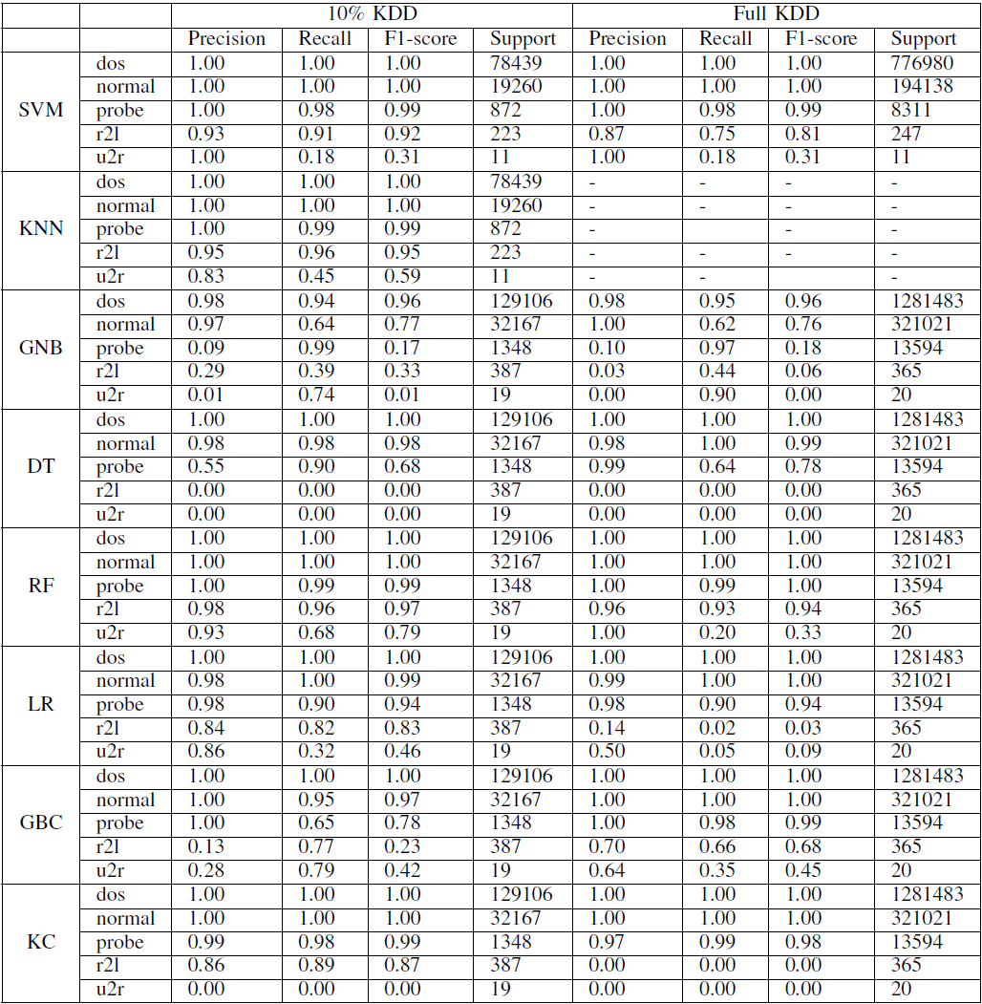
Evaluation & Results

Slide 13



Future Work
Online Prediction Intrusion Detection System
Providing a suitable dataset for real-world IDS applications
ML & DL IDS Benchmarking Framework

Slide 14
Thank you for listening.
End of presentation

Slide 15
Appendix

Slide 16
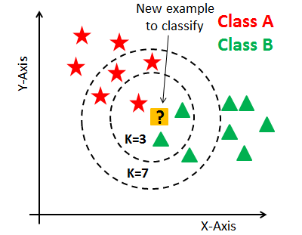
K-Nearest Neighbor Classifier
Supervised learning model
Uses k-closest training samples in feature space
Known as Lazy Learning model

Slide 17
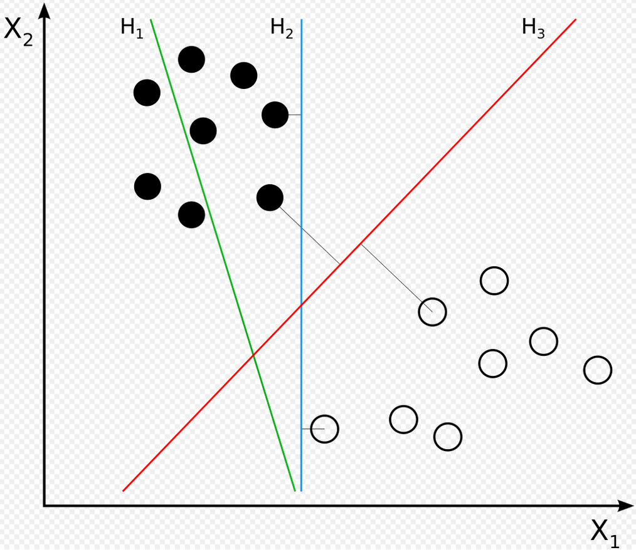
Support Vector Machines (SVM)
Supervised learning model
Creates a separating margin for classification
New data is classified based on whether it exceeds the determined threshold margin

Slide 18
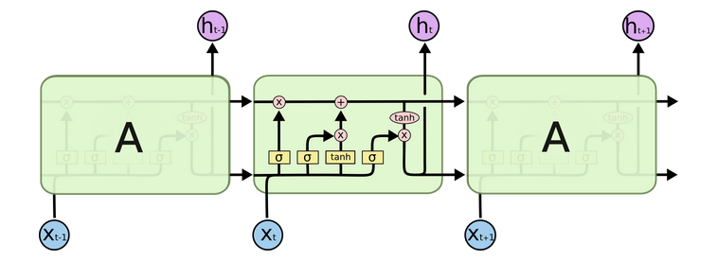
Long Short-term Memory
A type of Recurrent Neural Network
Short-term memory learns short chains of data recurrently
Uses Long memory to store learned relevant information

Slide 20
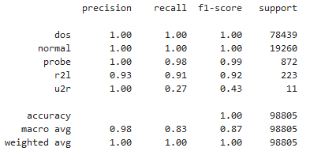
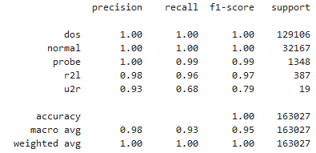


K-Nearest Neighbors:
Random Forest
Training Time: 7.11 seconds
Testing Time: 0.39 seconds
Accuracy: 99.9%
Training Time: 139 seconds
Testing Time: 281 seconds
Accuracy: 99.9%

Slide 21
User Interface:
The users of the system can be multi-levels:
General Audience Individuals
System Administrators
Defensive/Testing Security Professionals
Governmental Agencies taking security measures
Interface shall preview reports including:
Normal/Attack packets
Type of attack in packet
Time and frequency of attacks
Trends in attack frequency
Usual attack sources

Slide 22
Draft slide (this slide is hidden in presentation view)
Provide a system that uses:
Best accuracy ML method + 1 Dataset
Hybrid ML (2 methods) + 1 Dataset
Hybrid ML (2 methods) + 2 Datasets
Online Prediction Intrusion Detection System
Hybrid ML Solution on Mobile Devices

